Slide 1

NYSE Data Project Submission
NYSE Data Analysis Google Workbook HERE

Slide 2
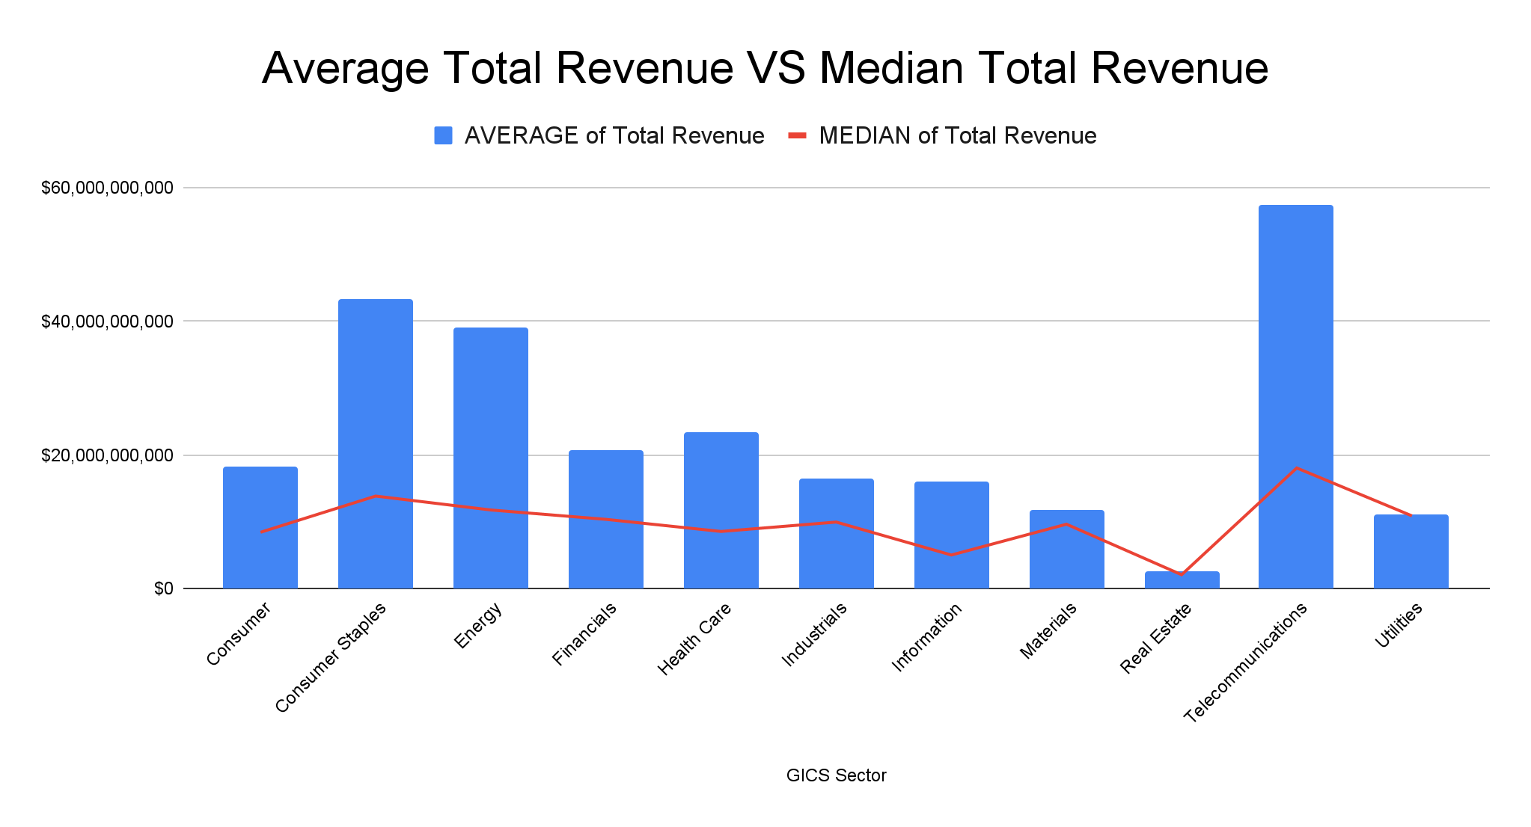
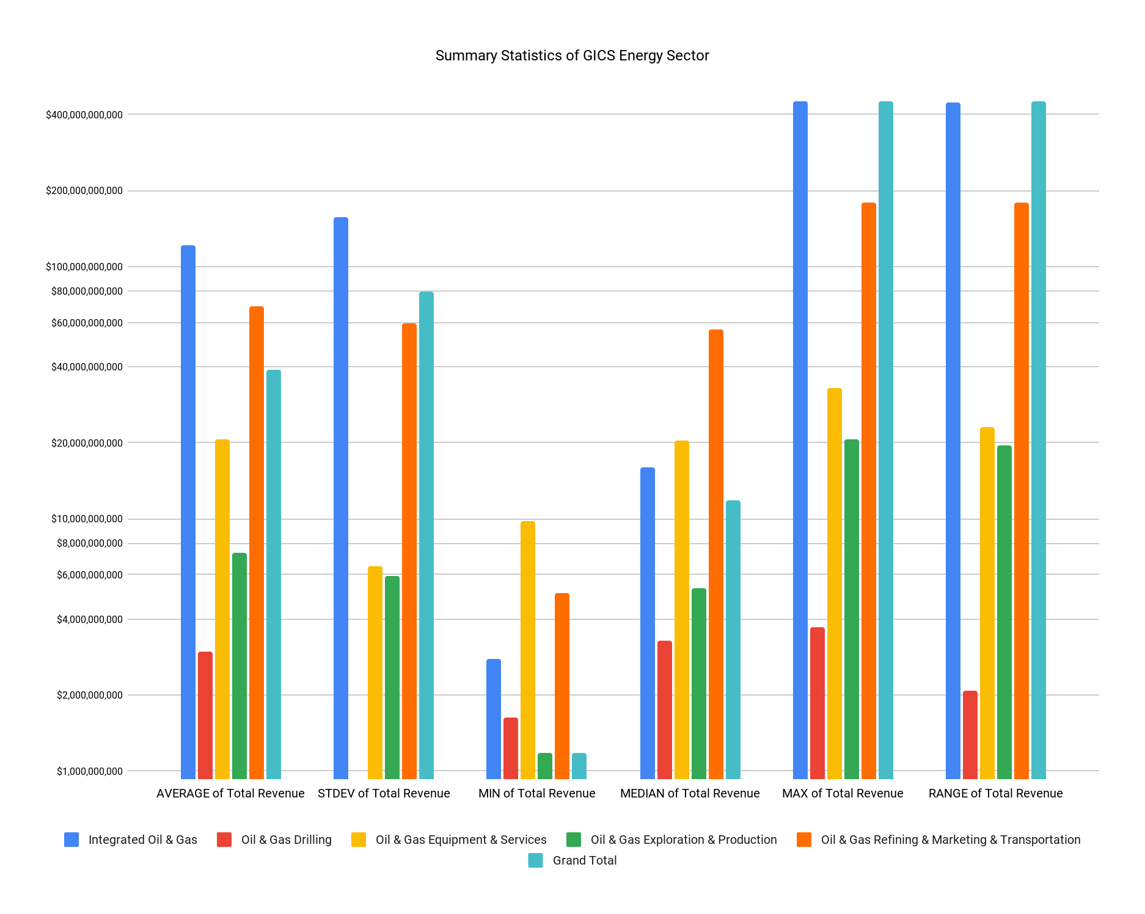
Summary of GICS Energy Sectors and It’s Sub Industries
Mean - The mean total revenue for companies categorized under Integrated Oil & Gas ($121,695,414,900) is the higher compared to all industries in the energy sector($38,984,796,516). It looks like Integrated Oil & Gas companies have a higher total revenue average than all Energy sector industries.
Standard deviation - The standard deviation for Integrated Oil & Gas companies is higher than the standard deviation of all Energy Sector industries. It seems there is higher variability of revenue within the Integrated Oil & Gas companies over all other companies in the Energy Industry sector.
Range - The range for Oil & Gas refining companies vs the range for Oil & Gas Drilling companies is drastically different by about $170 Billion. It looks like the Marketing & Transportation industries have about 5 times as many companies as the Drilling industry which can account for the variability in revenue.
Median- The median total revenue for Oil & Gas Refining Marketing & Transportation ($56,342,000,000) was higher compared to the median total revenue for all energy industries ($11,777,257,500). This indicates that there’s much higher revenue income in this sub industry than that of the overall sector.

Slide 3
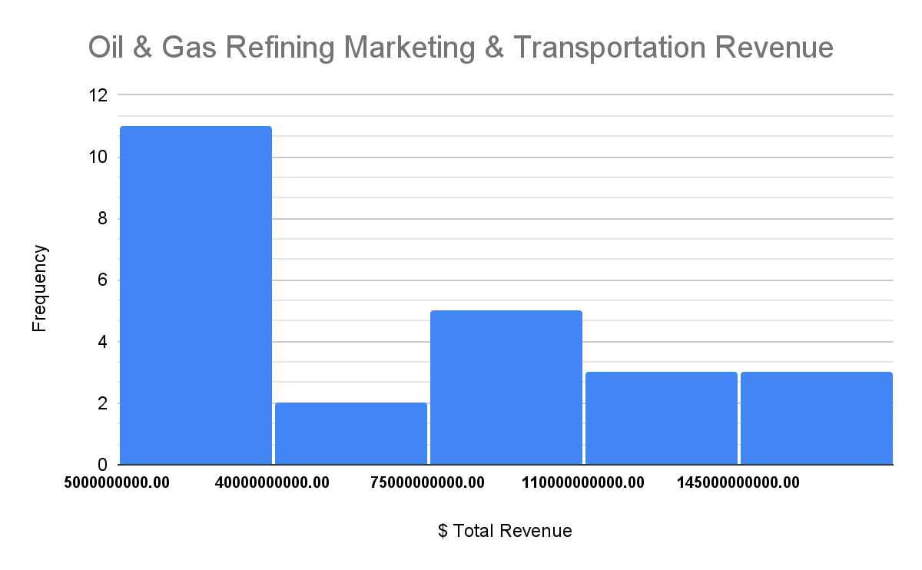
This Histogram shows the total revenue over 4 years in the Oil & Gas Refining Marketing & Transportation. This histogram is right skewed and shows that the majority of revenue is under $40 billion but the next largest revenue frequency is between $75 and $110 billion.
This sub industry had the highest Median of Total Revenue in the Energy Industry which leads me to believe these companies have periods of extremely high revenue compared to the other sub industries.

Slide 4
Works Cited
N/A

